Slide 1

CPE 490 Embedded Systems
dsPIC33 Top Level View (Data Sheet Sections 1,3, and 4)
I/O ports (Data sheet section 11)
C Top Level View

Slide 2
Reading Assignment
For next Thursday look over
Section 12 (Timer 1)

Slide 3
dsPIC33 Family Features
16 bit microcontroller
18 to 100 pin packages (more or less peripherals)
Cost of $1.96 to $5.67 depending on the size
Program memory of 6 Kbytes to 256 Kbytes
Data memory or RAM 256 to 30KBytes
Top CPU speed 40 MIPS
Many peripherals
Hardware Multiplier, Division, and MAC type functions
Notes:
16 bit data words are accessed from memory we have been used to 8 bits
In the PIC16F877A we had a maximum of 8 K program memory and 368 bytes of RAM
Fastest the 8 bit processor will run is 5 MIPS

Slide 4
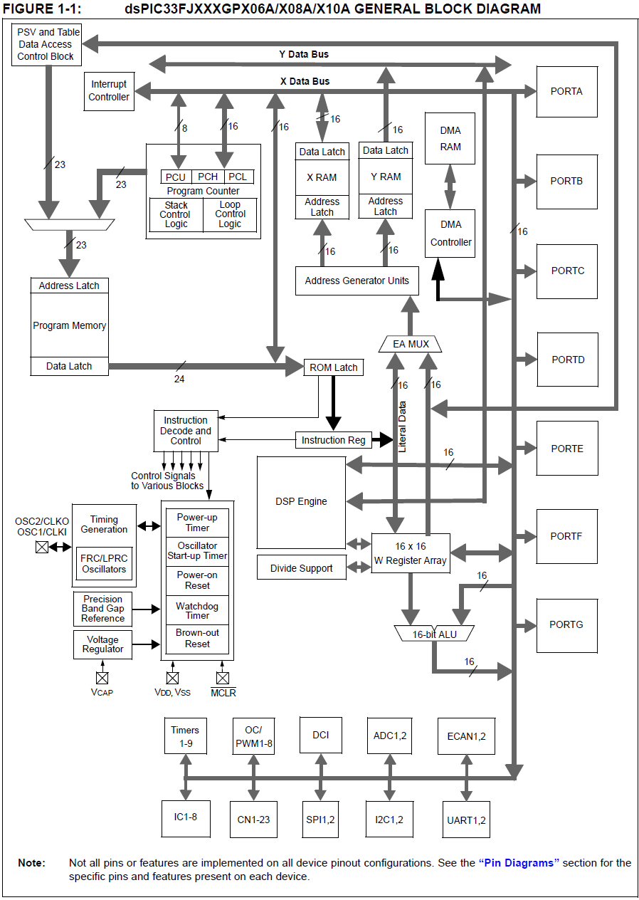
Notes:
Harvard architecture in that the data bus (16 bit) is totally separate from the instruction bus (24 bit)
SFR are now mostly 16 bits long
a powerful 16-bit architecture that seamlessly integrates the control features of a Microcontroller (MCU) with the computational capabilities of a Digital Signal Processor (DSP).
Program memory Can address up to 2^23 = 8 M Word addressing in program memory, That is the program memory is 16 bit or word addressable. Since an instruction is 24 bits a dummy upper 8 bits is added so the total space is 4 M instructions. but no parts take advantage of all of this space at this time. Our processor has 256Kbytes of memory this is only 87 thousand instructions.
Data memory is addressed by 16 bits or up to 64 Kbytes or 32 K words of RAM, as before the SFR exist in this address space. 2 k of SFR and 30 K of GP RAM

Slide 5
dsPIC33FJ256GP710A
100 pin TQFP
256 Kbytes of program flash memory (divide by 3 to get instructions)
30 Kbytes of RAM
9 Timers, 8 input captures, 8 PWMs
32 channels of A/D
2 UART, SPI, I^2C, CAN communication ports
85 GPIO pins (share function with peripherals)
Notes:
TQFP Thin Quad Flat Pack
Output compare modules can be made into PWM functions

Slide 6
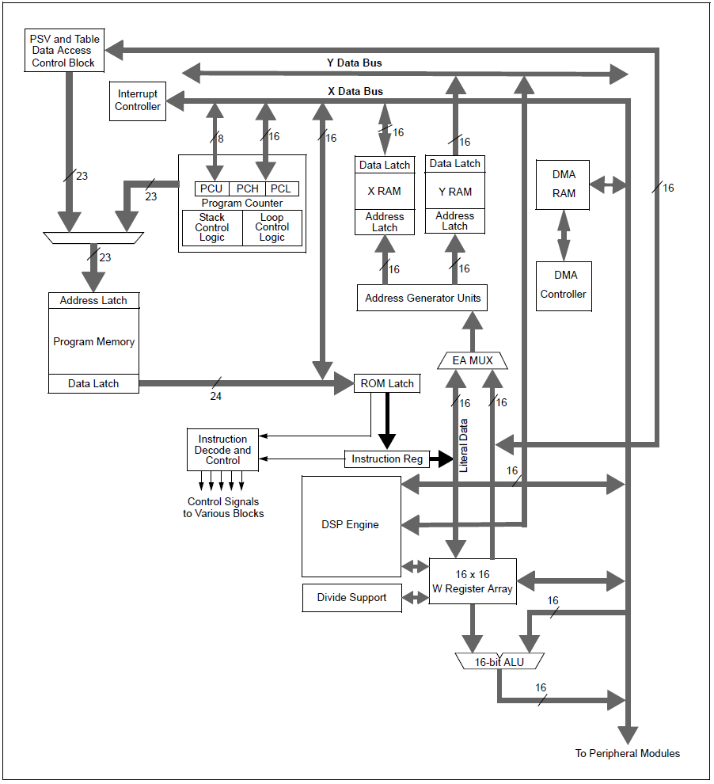
CPU
Notes:
The single w register has been replaced by 16 registers. The result in ALU can be put back into a Wreg
The X memory maps the entire memory and is used for MCU and DSP work while the Y memory is a subset of the total and only used in DSP commands
Up to 32 Kbytes of Program memory is mapped into data memory for easy lookup table access.
DMA stands for Direct memory access, and it allows a peripheral to grab memory even while the CPU is using it.
All instructions execute in a single cycle, with the exception of instructions that change the program flow, the double word move (MOV.D)
instruction and the table instructions. Overhead-free program loop constructs are supported using the DO and REPEAT instructions, both of which are interruptible at any point.

Slide 7
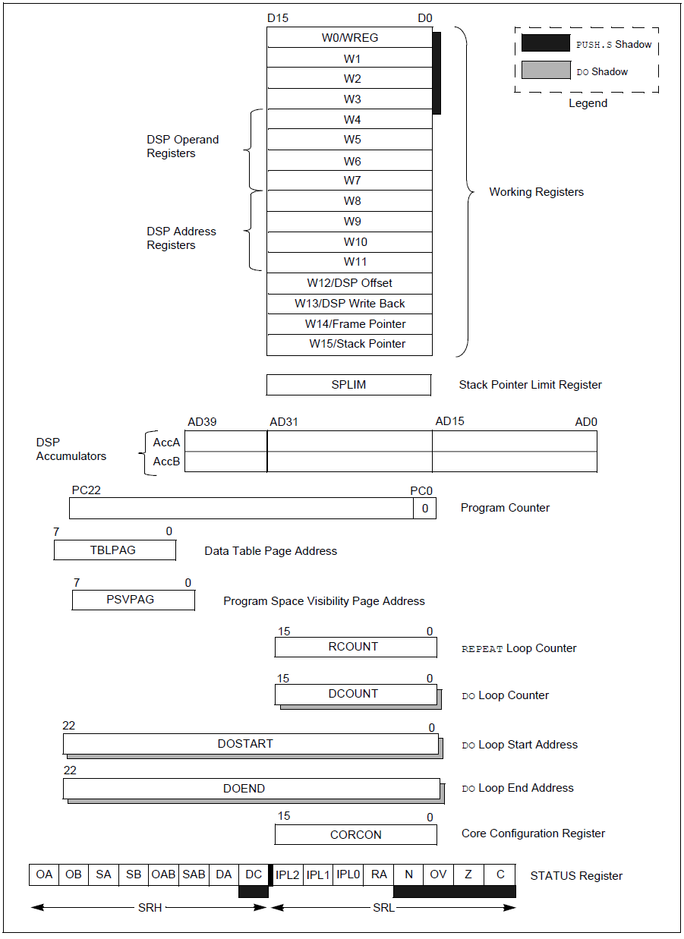
Programmers Module of the CPU
Notes:
The stack pointer W15 now just points to memory so the stack can be made to any size you want in data memory. It will start at 0x0800 (2K) right after the SFR space and it can grow as large as what is placed in SPLIM register.
Overhead free looping structures that are found in C are now supported in the assembly language, so jumps and in indexes are taken care of in hardware not with assembler instructions.
Frame pointer is used with LNK and UNLNK assembly commands to create a way to store data on the stack for local context.

Slide 8
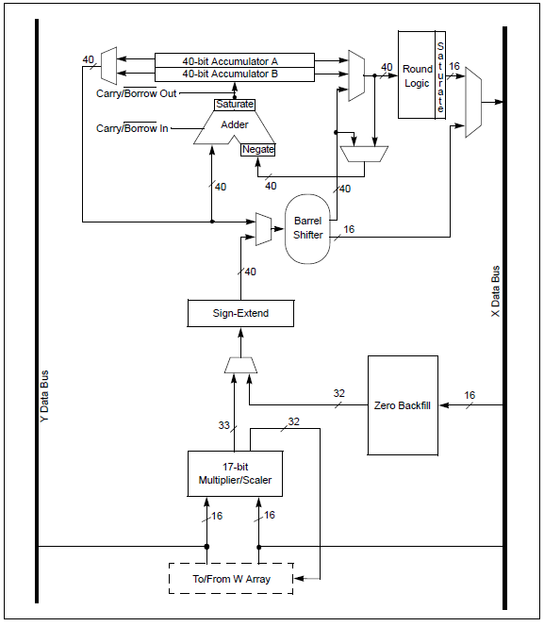
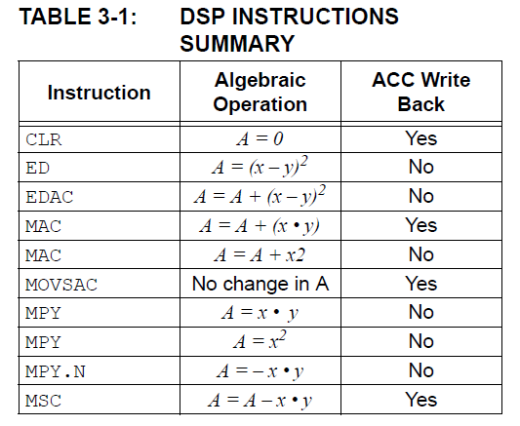
DSP Engine
Notes:
Hardware multiplier and barrel shift register (up to 16 shifts) execute every clock cycle along with an accumulate addition up to 40 bits. Both operands come from data memory removing the limitation of using a Working register.

Slide 9
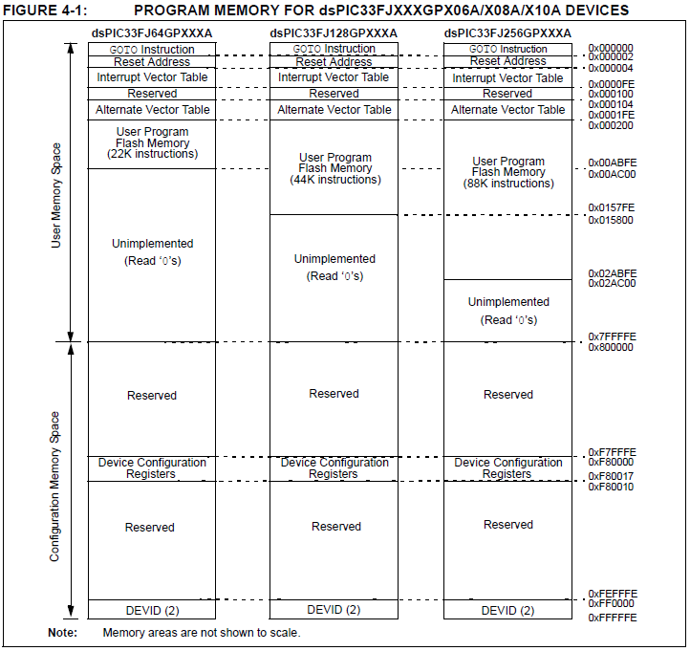
Program Memory
Notes:
Most important to recognize that program memory is addressed in word size chunks, not by byte or program instruction.
Notice at address 0 we have a goto instruction that is one of the few that takes two instruction words so the next instruction is just the completion of where to jump to.
Notice that the first 0x200 = 512 (word addressable) = 256 instructions are reserved for interrupts and traps

Slide 10
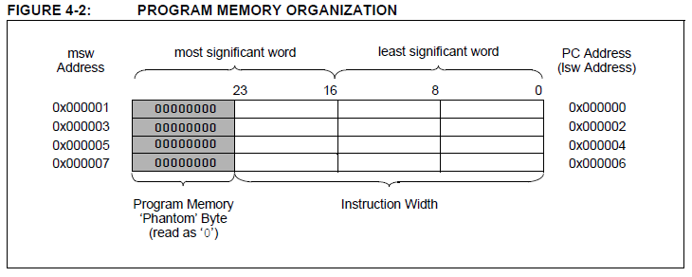
24 Bit Instructions in Program Memory
Notes:
Program memory can be modified dynamically. It also can be read and made seamlessly part of data memory
Class question: If memory is word addressable what is the increment of the PC? Is an odd address in the PC every possible?

Slide 11
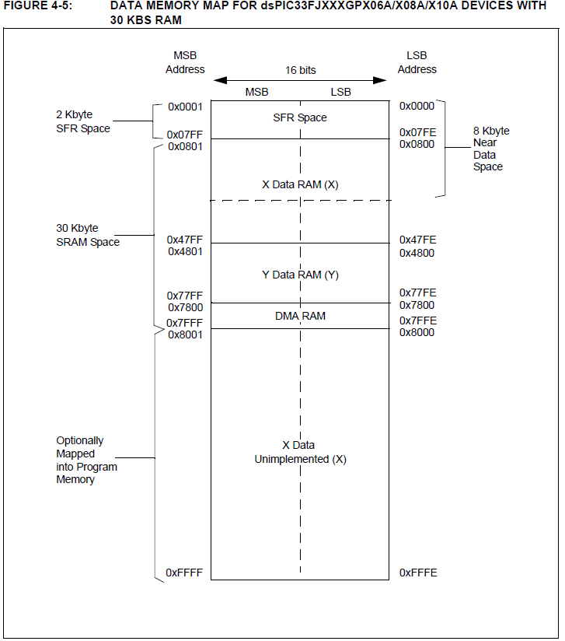
Data Memory
Notes:
Note that memory is byte addressable. Also that the first 2 K is for SFRs (much larger than 8 bit part)
Near memory is supported by a File register direct mode that is the address in embedded in the instructions. Addresses out of the near range are accessed with Register indirect addressing
DMA RAM can be used as GP RAM if desired
Program memory can appear as data memory.

Slide 12
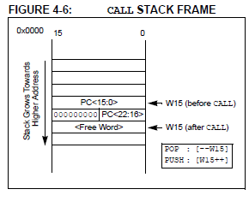
Software Stack
The stack is now located in GP RAM
Stack limit is set in SPLIM register
Interrupt events SRL is also saved automatically
Notes:
SRL low 8 bits of the status registre

Slide 13
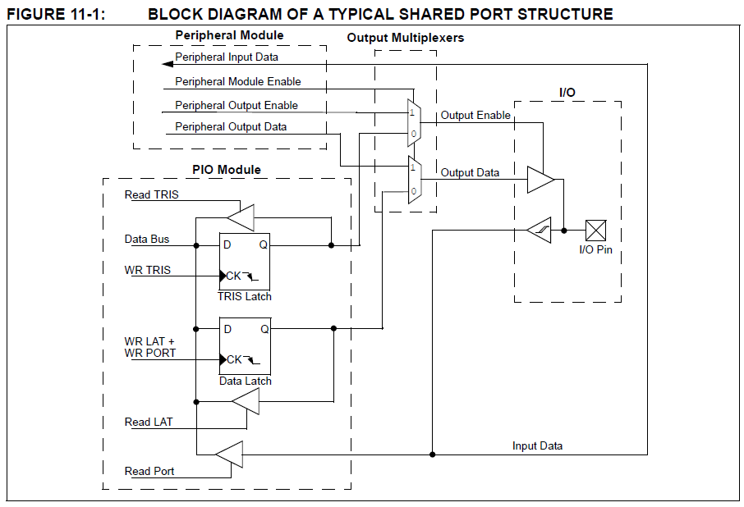
I/O Ports
Notes:
As before an I/O port can be configured with the TRISX buffer. What is different now is that:
the SFR registers like TRISA are now 16 bits in length
In general the I/O port is subservient to the peripheral function (analog input by default). Notice that the TRIS latch can completely ignored if the peripheral module is enabled.
Every port has three SFR now dedicated:
PORTX , TRIS, and the new LAT. If the peripheral module is not enabled writing to the PORT X will set the data output if TRIS latch is set to 0 (note error in diagram) then the pin will be driven to the PORT X value. A read of the PORTX latch will be a read of the actual state of the pin. Thus the value in the data latch could be different from the value read.
A write to the TRISX latch will set the latch to the write value, a read will read the value of the latch
A new LATX SFR if written to will be same as writing the PORTX SFR, a read will give the state of the latch not the pin value

Slide 14
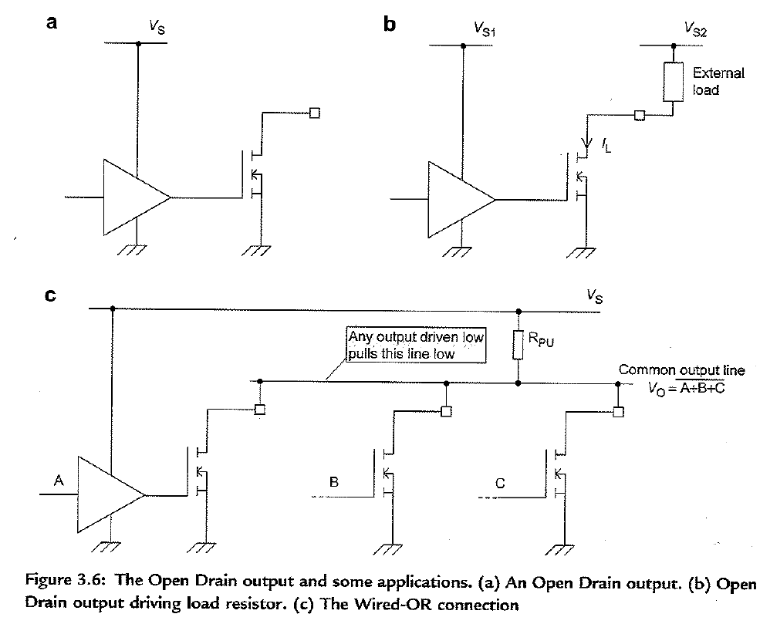
Common Drain Outputs
Notes:
Since the power supply on the dsPIC should be 3 – 3.6 V it is a problem when having to drive a load at 5V. Common drain output takes care of this problem. The ODCX SFR allows some of the I/O to use this technique OCDX being 1 will enable it. (0 at power up reset)

Slide 15
Anatomy of a C program
Free form programming
The column that a statement begins in has no meaning to the compiler (compare to assembler labels in column 1)
Comments
Declarations
Statements
White Space

Slide 16
Example C Program for dsPIC Series PIC Microcontroller
/***************************************************************************
Example1.
Introductory Example of C Programming, with dsPIC Series Microcontroller.
16-bit value output by Port B is continuously incremented.
WDB 01.14.13 Tested 01.14.13
***************************************************************************/
//Include 33FJ256GP710A header file, for all processor-specific declarations
#include <p33FJ256GP710A.h>
unsigned int counter; //specify counter as unsigned character
void main (void) //main function starts here
{
TRISB = 0; // initialise all bits of PORTB as output
counter = 1; //counter value is initialised to 1
AD1PCFGL = 0xFFFF; // turn off analog function on portb I/O pins
while (1)
{
PORTB = counter; // Move 'counter' value to Port B
counter = counter + 1; //Increment counter
}
}

Slide 17
Comments /* ….. */
/***************************************************************************
Example1.
Introductory Example of C Programming, with dsPIC Series Microcontroller.
16-bit value output by Port B is continuously incremented.
WDB 01.14.13 Tested 01.14.13
***************************************************************************/
//Include 33FJ256GP710A header file, for all processor-specific declarations
Start with /* end with */
Can be multiple lines in between
No problem with free space
// used for a single line comment
Be generous with comments

Slide 18
Declarations
unsigned int counter; //specify counter as unsigned character
Create program elements and indicate properties
All variables and functions must be declared
Usually appear at the beginning of the program

Slide 19
Statements
TRISB = 0; // initialise all bits of PORTB as output
counter = 1; //counter value is initialised to 1
AD1PCFGL = 0xFFFF; // turn off analog function on portb I/O pins
Where the action takes place
Perform mathematical or logical operations and establish program flow
Every statement ends in a semicolon
Notes:
The examples are a mathematical assignment statement or and expression statement

Slide 20
Code Blocks
while (1)
{
PORTB = counter; // Move 'counter' value to Port B
counter = counter + 1; //Increment counter
}
A block of declarations and statements
Contained within curly brackets {}
Notice the absent of semicolon
Can be nested, use tabs to set each block vertically in its own column

Slide 21
Use of Space
while (1)
{
PORTB = counter; // Move 'counter' value to Port B
counter = counter + 1; //Increment counter
}
OR
while (1){PORTB = counter; // Move 'counter' value to Port B
counter = counter + 1;} //Increment counter
Blank spaces and blank lines are ignored by the compiler.

